Slide 1


Slide 2

@DataProvider
To Run multiple times with different set of data we use Dataprovider.

Slide 3
Example
package thrusday;
import org.openqa.selenium.By;
import org.openqa.selenium.WebDriver;
import org.openqa.selenium.chrome.ChromeDriver;
import org.testng.annotations.DataProvider;
import org.testng.annotations.Test;

Slide 4
public class Demo {
@DataProvider
public Object[][] getdata()
{
Object[][] a=new Object[3][2];
a[0][0]="abcdef";
a[0][1]="abcdef";
a[1][0]="123456";
a[1][1]="123456576573";
a[2][0]="123bha";
a[2][1]="123byr";
return a;
}

Slide 5
@Test(dataProvider = "getdata")
public void login(String us,String password) throws InterruptedException
{
System.setProperty("webdriver.chrome.driver","./s/chromedriver.exe"); WebDriver driver = new ChromeDriver();
driver.get("https://demo.actitime.com/login.do");
driver.findElement(By.id("username")).sendKeys(us);
driver.findElement(By.name("pwd")).sendKeys(password);
Thread.sleep(5000);
driver.close();
}
}

Slide 6
Parallel Execution
To Run same script on multiple browser we use parameters and in order to run at the same time
We use Parallel option provided by TestNG

Slide 7
Example
package thursday;
import org.openqa.selenium.By;
import org.openqa.selenium.WebDriver;
import org.openqa.selenium.chrome.ChromeDriver;
import org.openqa.selenium.firefox.FirefoxDriver;
import org.testng.annotations.Parameters;
import org.testng.annotations.Test;

Slide 8
public class Parallel {
public WebDriver driver;
static
{
System.setProperty("webdriver.chrome.driver","./s/chromedriver.exe");
System.setProperty("webdriver.gecko.driver","./s/geckodriver.exe");
}
@Parameters({"browsername"})
@Test
public void test(String browser) throws InterruptedException
{
if(browser.equals("chrome"))
{
driver=new ChromeDriver();
}
else
{
driver=new FirefoxDriver();
}

Slide 9
driver.get("https://demo.actitime.com/login.do");
driver.findElement(By.id("username")).sendKeys("admin");
driver.findElement(By.name("pwd")).sendKeys("manager");
driver.findElement(By.xpath("//div[.='Login ']")).click();
Thread.sleep(5000);
driver.close();
}
}

Slide 10
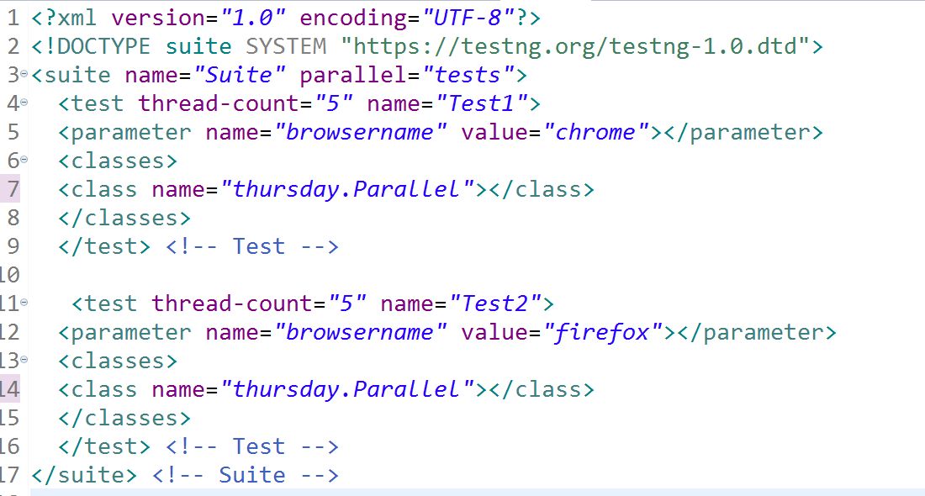
TestNG.XML File

